Slide 1
WEEKLY AUTOMATION REPORT
Company - Norton Lifelock
Project Guide - Ms. B. Siva Shankari
Mentor - Raja Ganapathy
Yuvaraj T
2019202063
MCA Regular
Batch - 2

Slide 2
TOC
Motivation & Objective
Introduction
Implementation Platform / Framework
Overall Architecture
Modules
Output Screenshots
References

Slide 3
MOTIVATION AND OBJECTIVE
To create a Web Automated Tool to automate IT work maintain weekly report of Jira Dashboard
To develop script to export dashboard as PDF for regular interval
To capture and crop screenshots of required graphs in Dashboard page
To Scrape the required data from Dashboard page by Web scraping

Slide 4
Introduction
We, at Norton LifeLock , designing a tool highly focus on Web Automation and Automated Mailing
This project is to create a Web Automated Tool to automate the IT work to maintain the weekly report of our Jira Dashboard
Project Domain
Web Automation
Web Scraping
Mail Automation

Slide 5
Implementation Platform / Framework
Code editor - Visual Studio Code
Language - Java Script
Environment - Node JS

Slide 6
Major Libraries used
Puppeteer
JIMP - Javascript Image Manipulation Program
NodeMailer
FS - File System

Slide 7
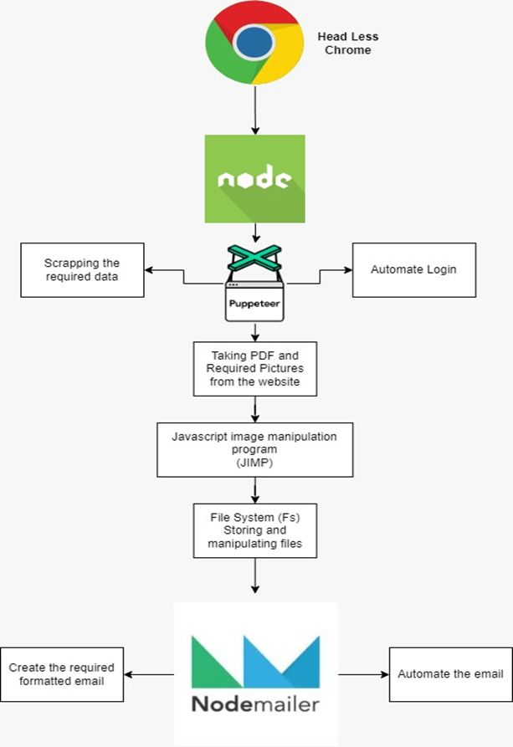
Overall Architecture

Slide 8
List of Modules
Automate the Browser and Web pages
Scraping of Data
Capturing Snapshots and PDF
Image manipulation
File system management
Designing the Email
Automate the Email

Slide 9
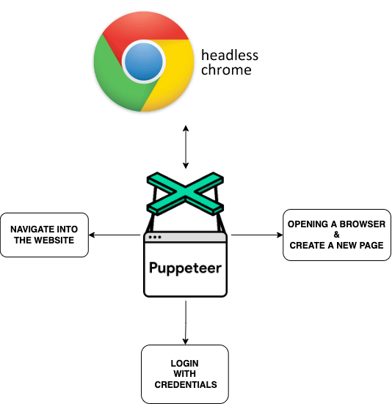
Automate the Browser and Web pages
Opening the Headless Chrome
Add New Page
Login into Website
Navigation between screens using the Puppeteer

Slide 10
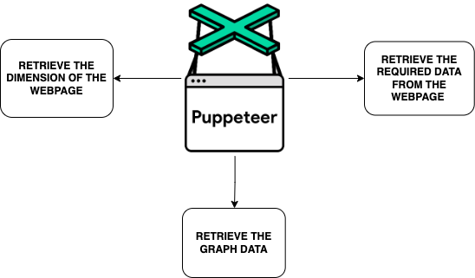
Scrapping of data
Retrieve the required data from the website
Retrieve the height and width the webpage
Retrieve the graphs data and dimensions
Using the Puppeteer

Slide 11
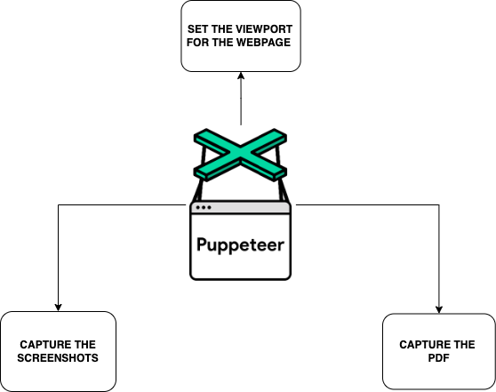
Capture the Snapshots and Pdf
Set the Viewport of the webpage
Capture the snapshots
and PDF using the Puppeteer

Slide 12
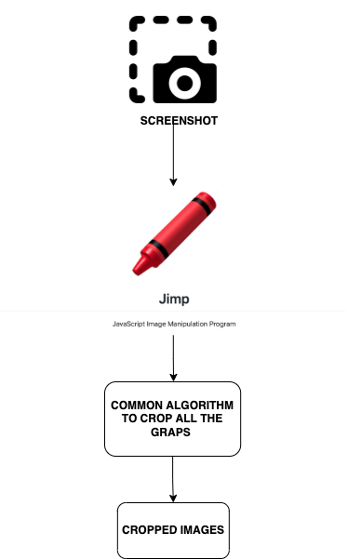
Image Manipulation
By using the JIMP (Javascript Image Manipulation Program) library crop the each and every graphs in the screenshots
Write the generalize function to crop the graphs

Slide 13
File system management
In this system, File Systems is used to manage directories, image files and text files
Create a new file and store the data collected from the web-pages
Read the text files and get data from them

Slide 14
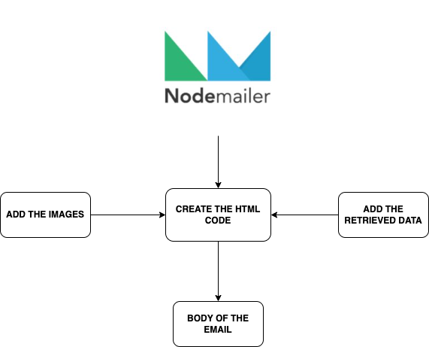
Designing the Email
Create the body of the email in the required format
By using the Node Mailer, create the body of email as Html code
Attach PDF and the Snapshots in the email

Slide 15
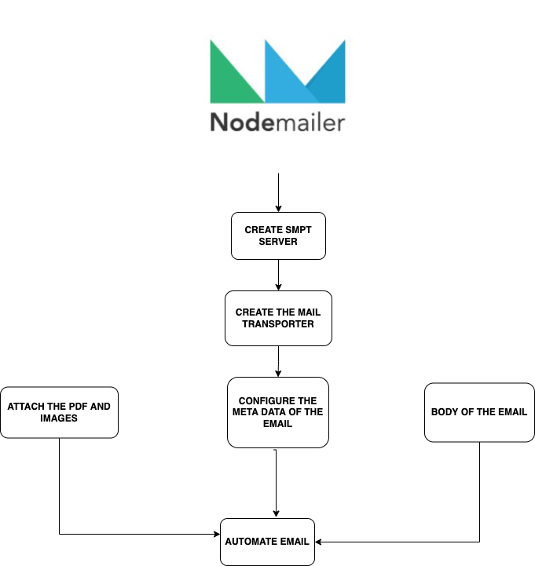
Automate the Email
Provide the required data for the email such as Sender address, Receiver addresses , email subject
Create the SMPT server and then add information of the email and send it by using Node mailer

Slide 16
References
•https://www.nortonlifelock.com/us/en/
•https://nodejs.org/
•https://pptr.dev/
•https://nodemailer.com/about/
•https://www.npmjs.com/package/jimp
•https://github.com/oliver-moran/jimp
•https://nodejs.dev/learn/the-nodejs-fs-module

Slide 17

Thank you!

